Slide 1
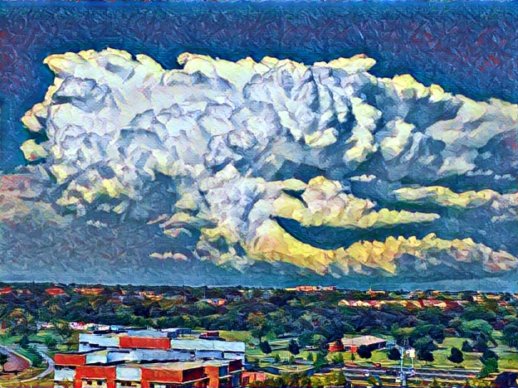
Learning High-Level Representations of Spatial Atmospheric Data with Generative Adversarial Networks
David John Gagne II
National Center for Atmospheric Research
June 1, 2017
Email: dgagne@ucar.edu
Collaborators
Sue Ellen Haupt, Doug Nychka,
Ryan Sobash, Rich Loft

Slide 2
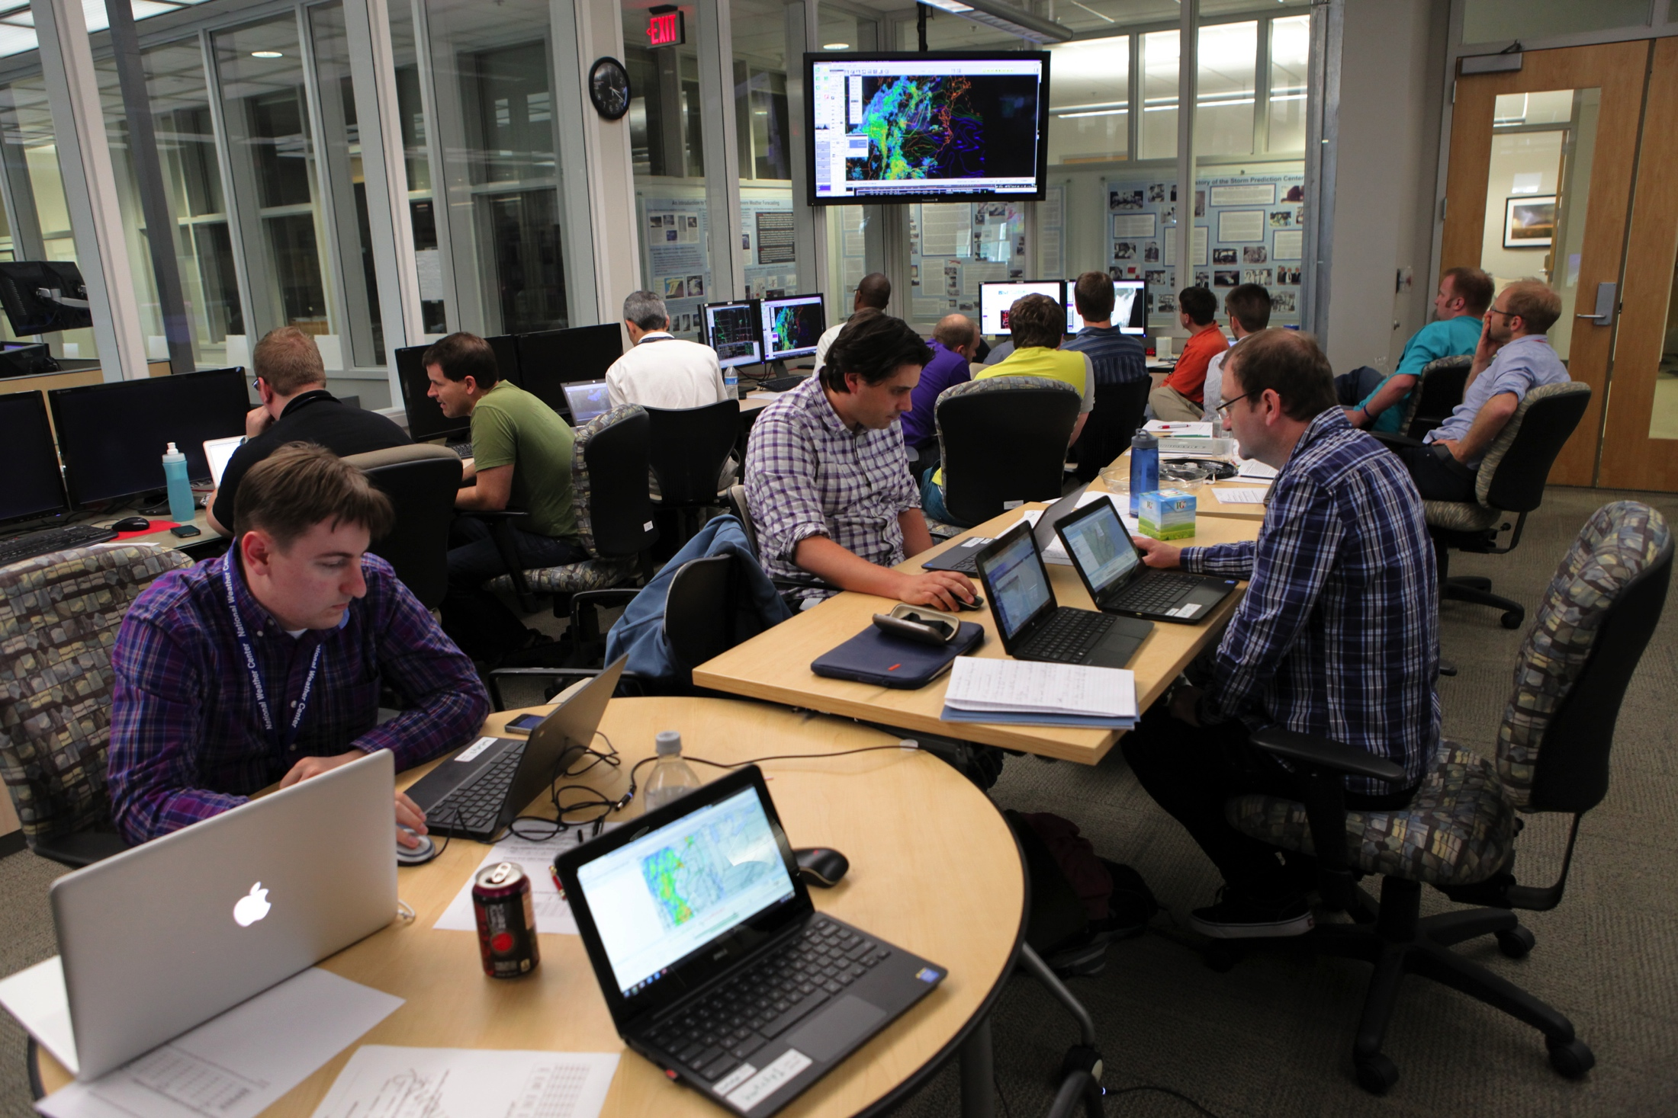
Personal Background
Current Position: Advanced Study Program Postdoctoral Fellow at the National Center for Atmospheric Research
Ph.D., M.S., and B.S. in Meteorology from the University of Oklahoma
Graduate Advisor: Dr. Amy McGovern
First data science experience: 2007 CASA REU in Oklahoma with Dr. McGovern working on automated storm classification with clustering and decision trees
Developed and applied decision tree ensemble models for severe storm and renewable energy forecasting

Slide 3
Motivation
Forecasters interrogate weather imagery, including radar and satellite, to identify features related to storm intensity and potential hazards
Traditional machine learning and image processing techniques have limits on what kind of spatial information they can analyze
Spatial statistics
Hand-crafted object/feature detection
Deep learning models can learn about spatial information from raw, gridded data
Goal: Investigate how deep learning can be used to encode storm information and make severe weather predictions
Simulated Radar Image from ensemble.ucar.edu

Slide 4
What is Deep Learning?
Definition: “A class of machine learning models that consist of neural networks with multiple specialized layers. The different layers build an abstract multiscale feature representation in the input dataset”
Machine learning models: Statistical model that learns patterns from large datasets and uses the patterns to make predictions
Neural network: Type of machine learning model that consists of multiple layers of perceptrons that can build nonlinear approximations of smooth functions
Multiple specialized layers: layers that transform input data to extract spatial and temporal information
Abstract multiscale feature representation: a way for the neural network to describe high-level concepts as a hierarchy of simpler concepts

Slide 5
Convolutional Neural Networks
Traditional neural networks are composed of “fully connected” layers
Convolutional neural networks use specialized layers that perform localized transforms to the data as it passes through the network
Image data is transformed from
Convolution
Batch Normalization
Activation
Max Pooling
Subtract mean and divide by standard deviation that are updated with each training batch
Calculate maximum in each 4x4 box to reduce dimensions of image. Can be replaced with strided convolutions.
Dot product of filter with local area of pixel
Nonlinear transform:
Rectified Linear Unit (ReLU): max(0, x)

Slide 6
Unsupervised Deep Learning
Autoencoders
Neural network that reconstructs input values after sending them through a low-dimensional hidden layer
Low-dimensional layer a latent vector that can be used for dimensionality reduction, i.e. non-linear PCA
Autoencoder Challenges
Latent vector will not learn useful representations without regularization
Autoencoders minimizing pixel-wise reconstruction error tend to create blurry images
Image from https://blog.keras.io/building-autoencoders-in-keras.html

Slide 7
Generative Adversarial Networks
Unsupervised method of learning complex feature representations from data
Originally proposed by Goodfellow et al. (2014)
Requires 2 neural networks
Generator: Creates synthetic samples similar to training data distribution
Critic: determines which samples are from the training set and which are synthetic
Both networks have a “battle of wits” until the critic assigns similar probabilities to real and synthetic samples
Advantages
Unsupervised pre-training: learn features without labeled data
Dimensionality reduction: reduce image to smaller vector
Learns sharper, more detailed features than autoencoder models
Disadvantages
Not guaranteed to converge or produce diverse samples
Best settings still area of active research
Does not include an explicit encoder network

Slide 8
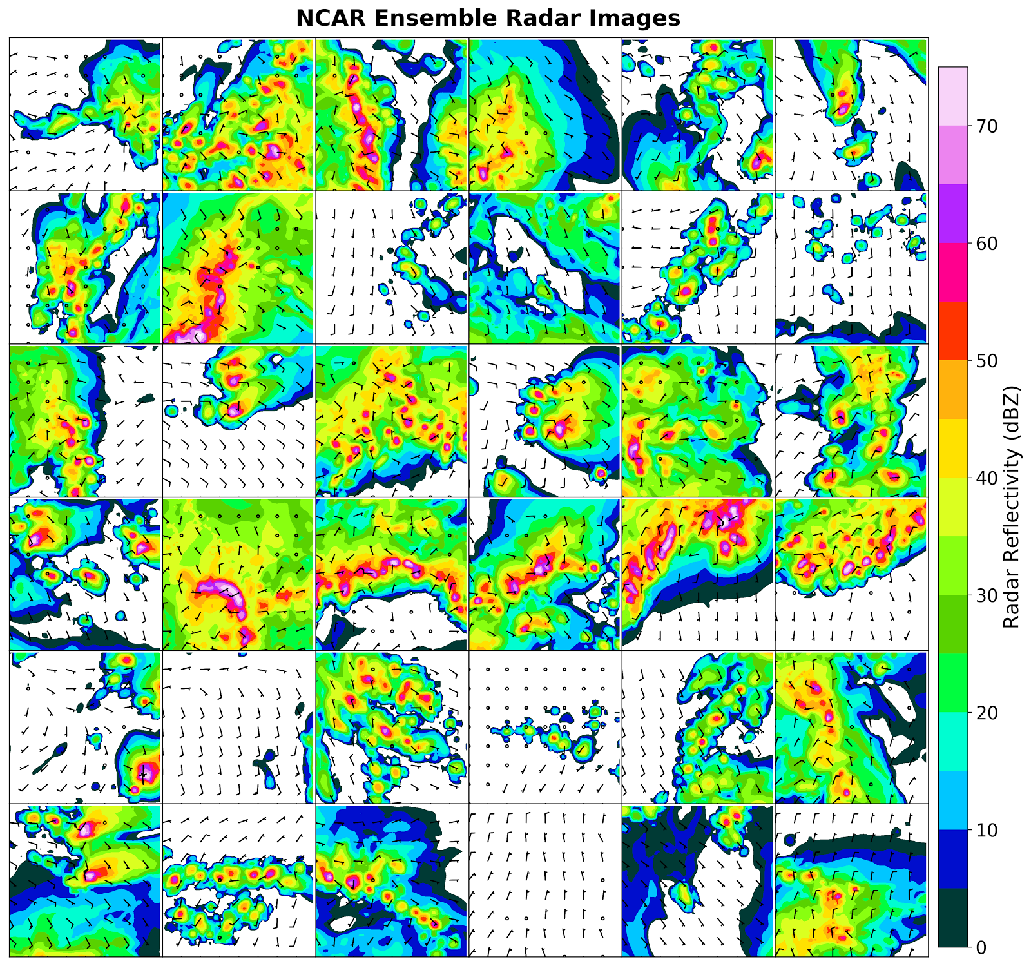
Data: NCAR Ensemble Storm Patches
NCAR Ensemble: Set of convection-allowing daily WRF-ARW runs by NCAR MMM
3 km grid spacing
10 members
48 hour forecast window
Run daily since April 2015
Storm Patch: 64x64 grid point patch centered around updraft area > 12 m/s
Variables: Composite Reflectivity, 2m Temperature and Dewpoint, W-E and S-N wind components

Slide 9
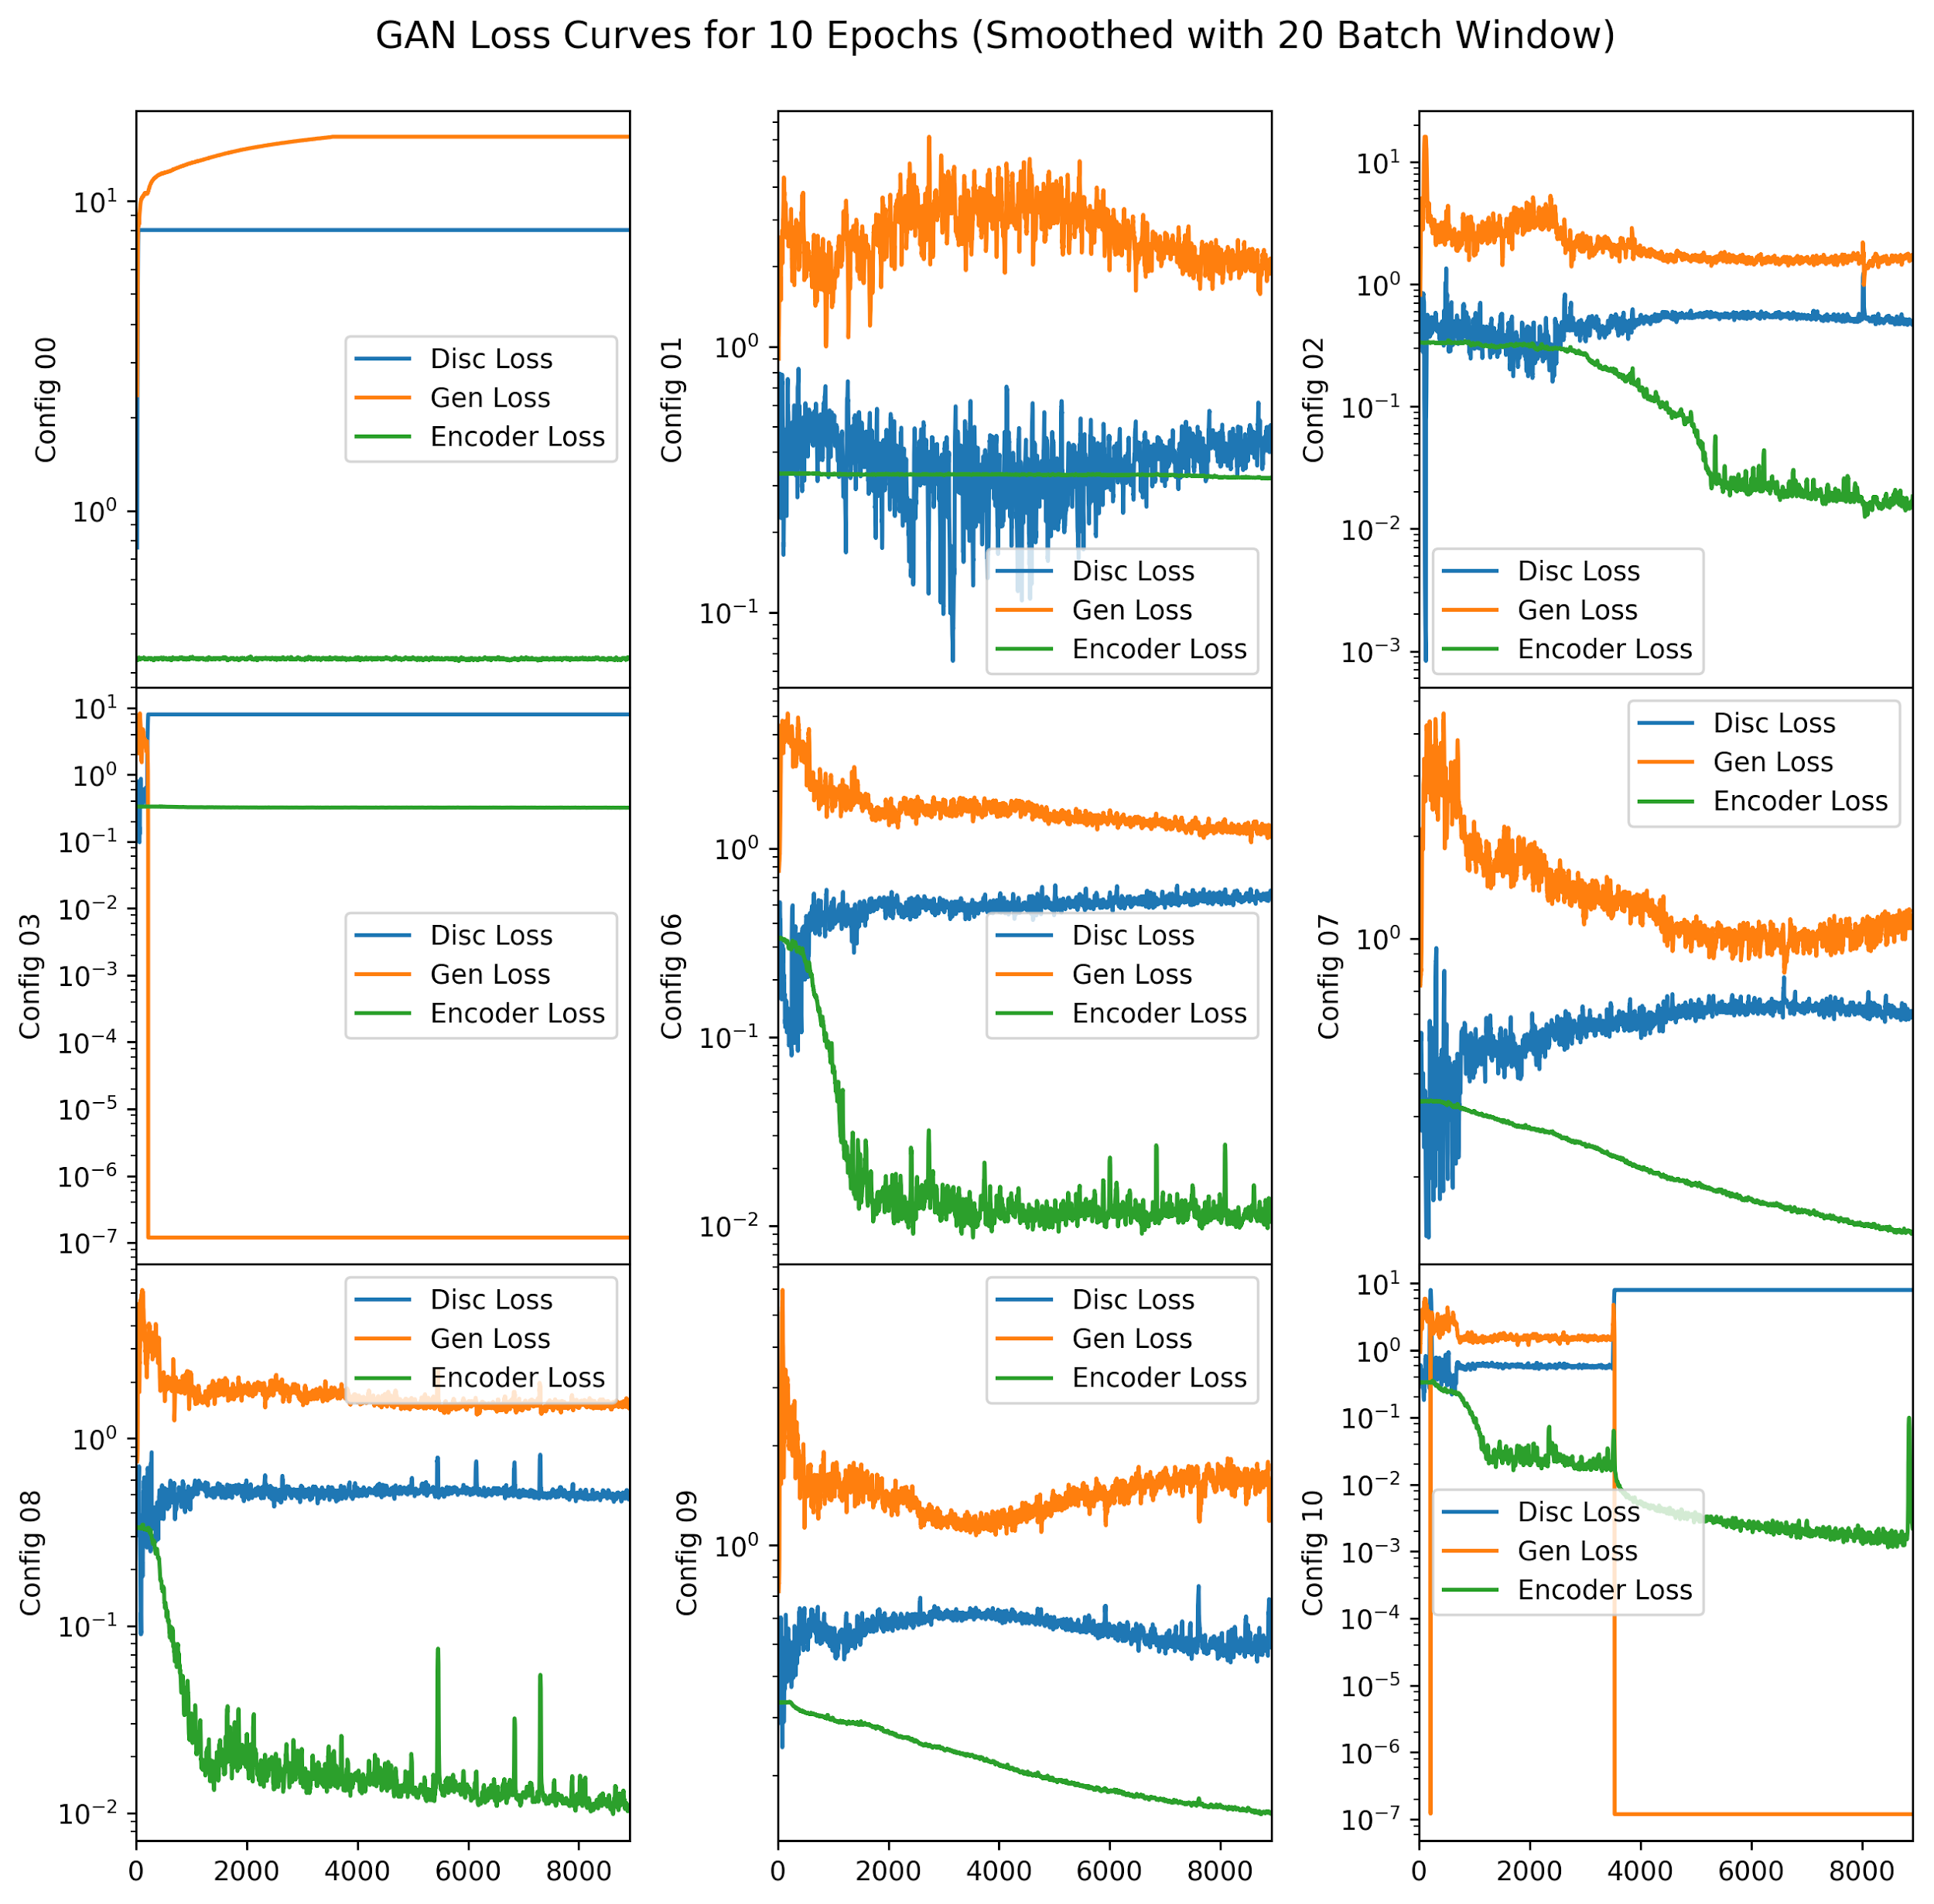
GAN Loss Curves
Configurations 0, 3, and 10 all had their gradient collapse during training
4, 5, and 11 never completed training, but there is evidence of gradient collapse with them too
Configurations that did not collapse all produced realistic samples

Slide 10

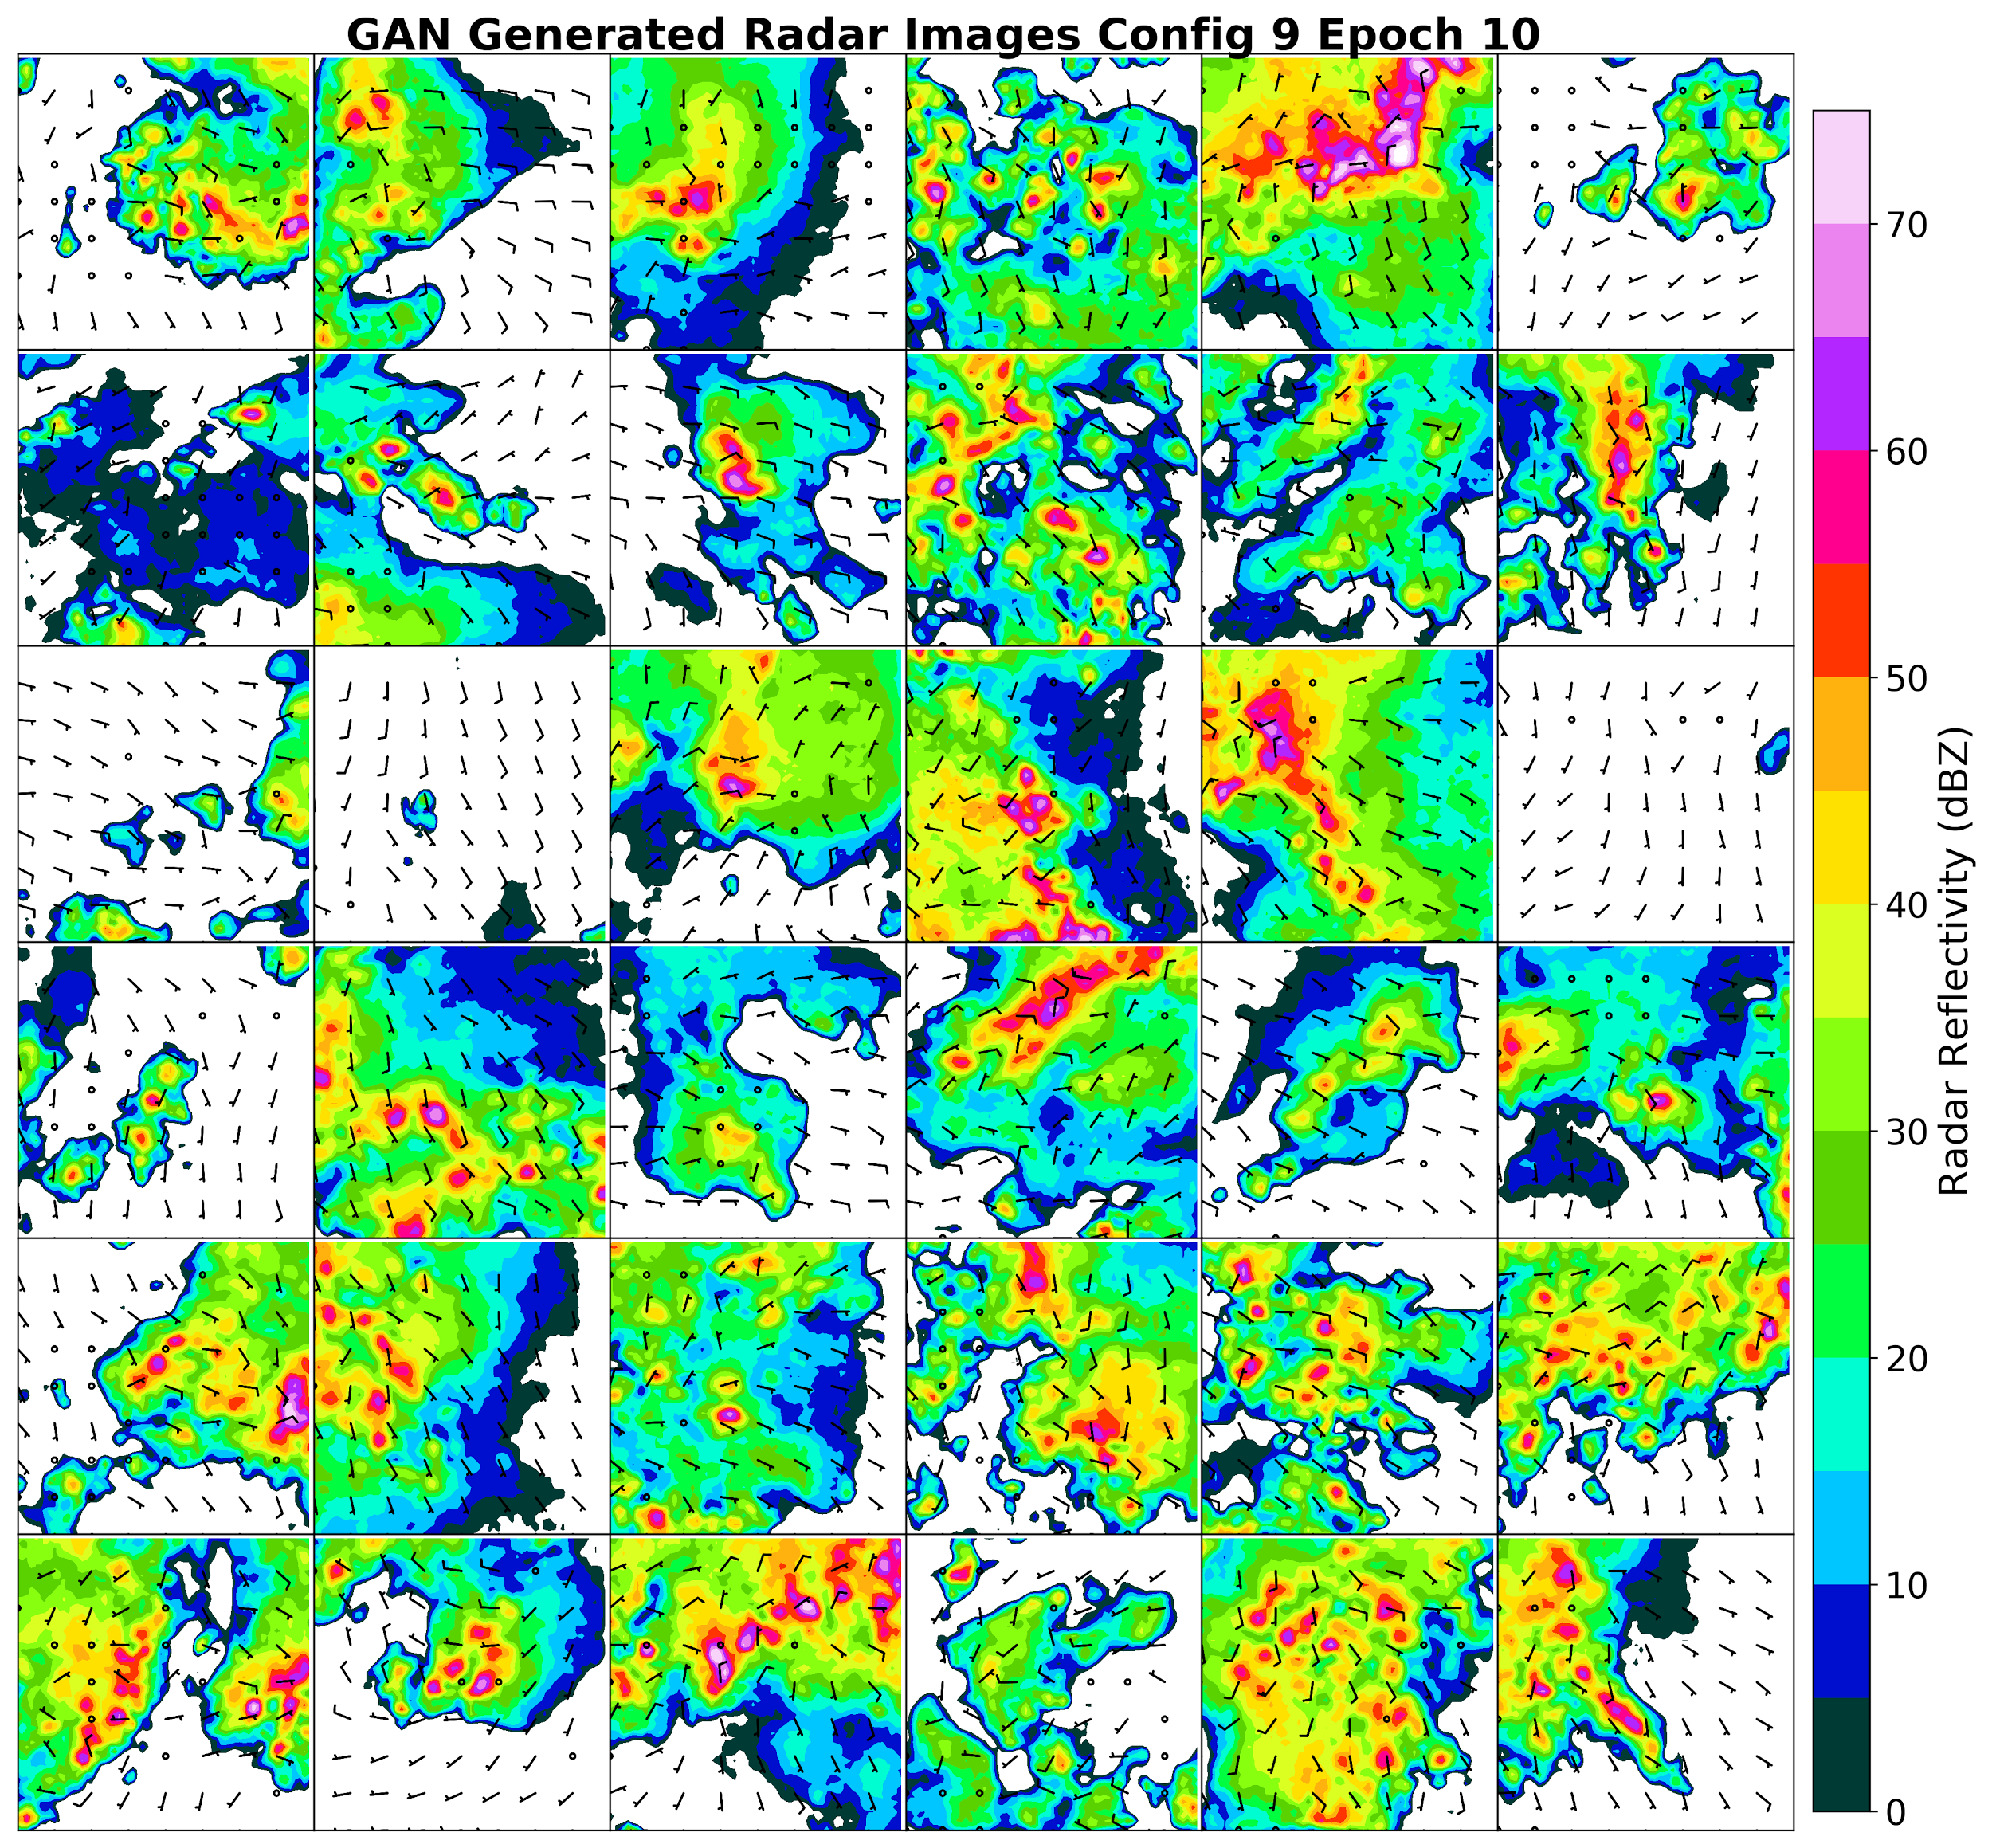
Synthetic GAN Samples (Successful Network)

Slide 11
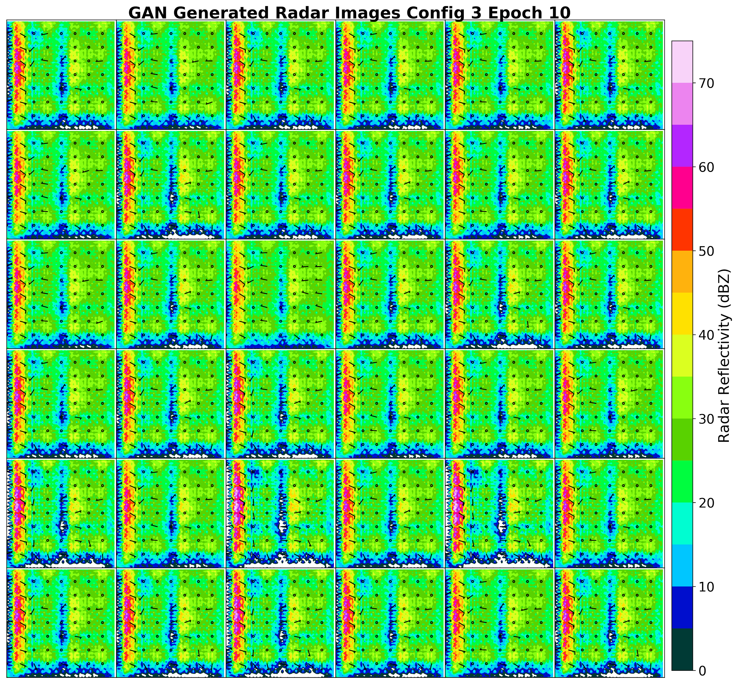
Synthetic GAN Samples (Failure Network)

Slide 12
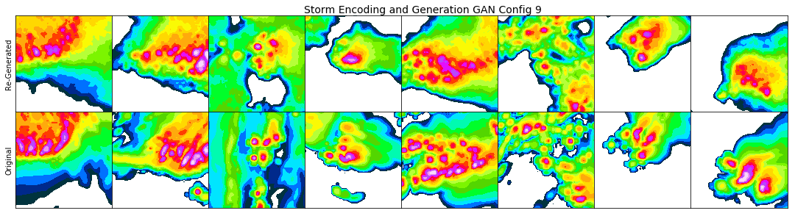
GAN Encoder Training Methods
1. Train encoder network from generator by minimizing latent vector MSE
Captures larger scale details
Cannot perfectly replicate latent vector, especially for extreme values
2. Use discriminator loss to train generator and encoder networks together
Implemented by Adversarially Learned Inference and Adversarial Feature Learning
Attempted to implement; did not learn any structures
3. Auto-encoder GAN hybrid
E.g., VAE-GAN, adversarial autoencoders
Alternate between minimizing GAN and autoencoder loss
4. Different GAN loss
Wasserstein GAN, BEGAN, EBGAN
Empirical evidence that other losses make GAN training more stable

Slide 13
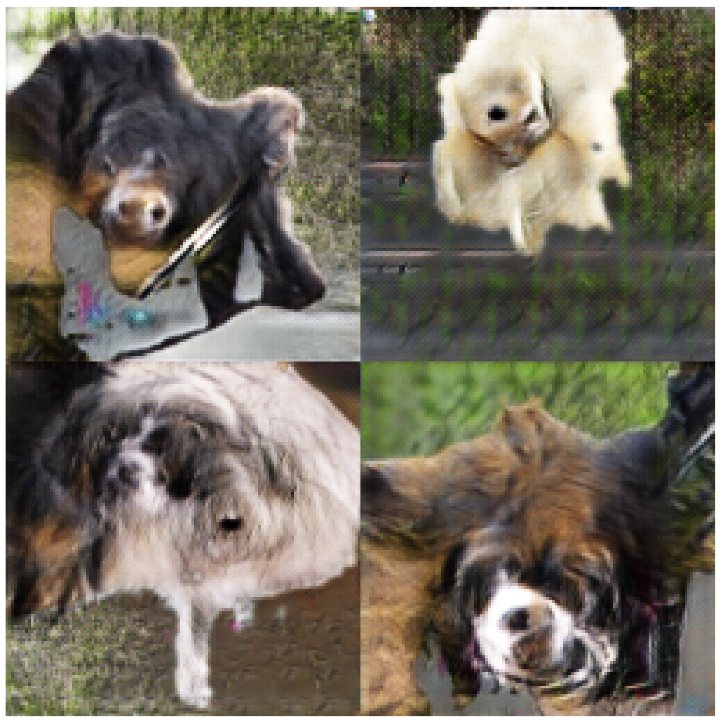
GAN Challenges
Ensuring that GANs can converge more consistently
What loss functions and architectures work best for this?
Interpreting the latent feature vector
How does each feature link with input image?
Can we generate a more semantic vector
Evaluating the quality of GAN samples statistically
Original GAN loss not linked to realism of samples
Use physical rules to grade samples
Why certain network architectures work or not
Architecture design more art than science
Necessary vs. unnecessary elements
How deep does network need to be?
GANimals (Salimans et al. 2016)

Slide 14
Summary
Generative adversarial networks have shown the ability to create physically realistic synthetic images
Used GANs to produce realistic storms and associated surface environments
Many challenges in getting GANs to work consistently and encode and recover information
Will continue to test new GAN configurations and evaluate if/how they can improve severe weather hazard forecasts
Contact Me
Email: dgagne@ucar.edu
Twitter: @DJGagneDos
Github: djgagne
Acknowledgments
This work is funded by the National Center for Atmospheric Research. NCAR is sponsored by the National Science Foundation. Computing was performed with the NCAR HPC Futures Lab. The NCAR Ensemble was developed by Glen Romine, Craig Schwartz, Ryan Sobash, and Kate Fossell.

